Slide 1
Git-GitHub

Slide 2
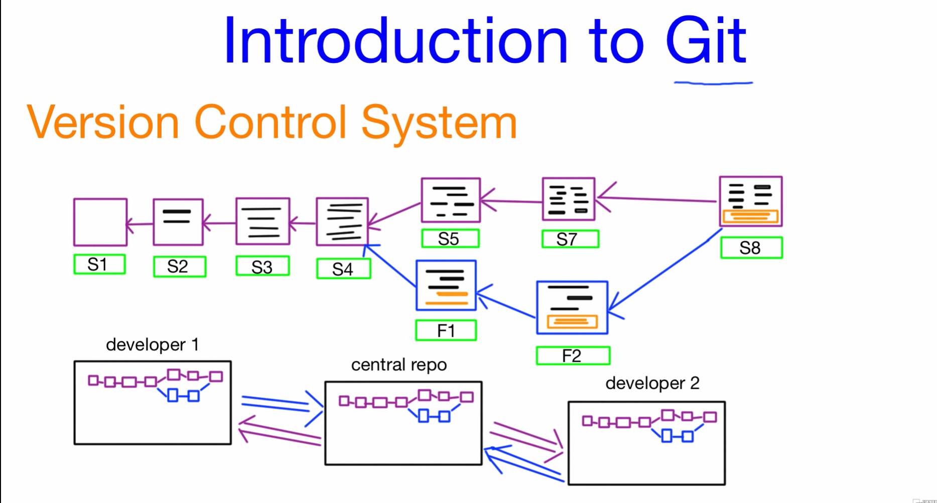

Slide 3
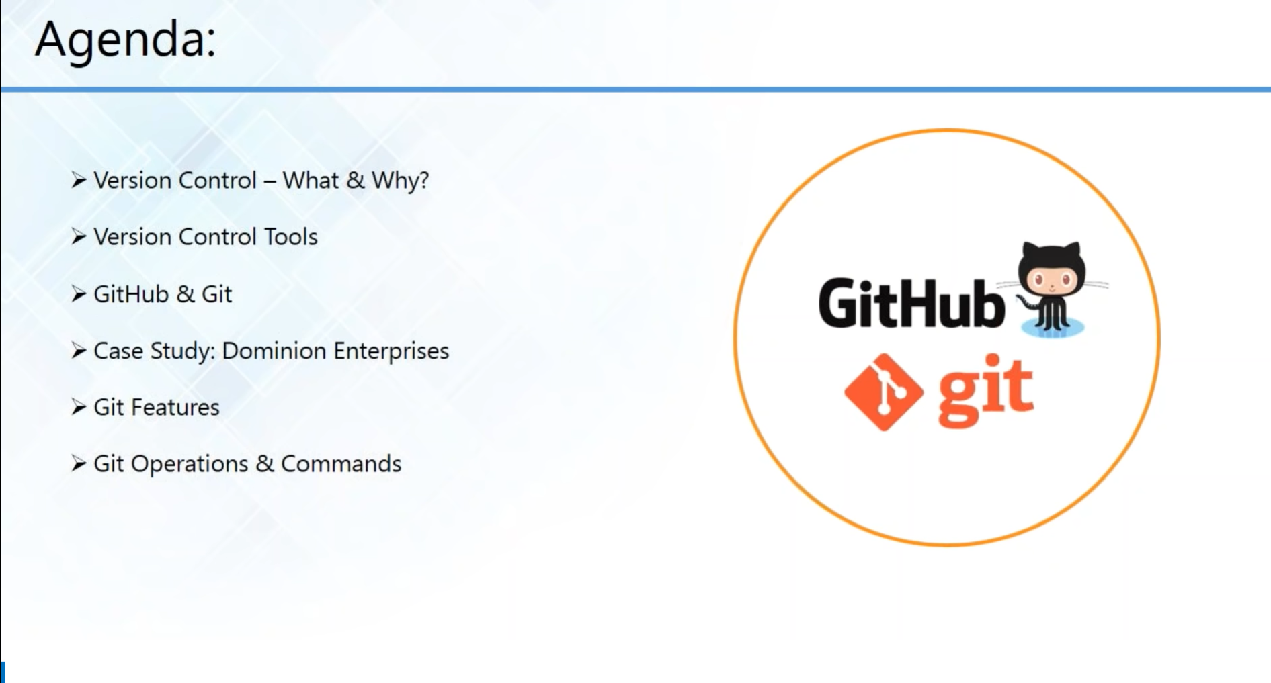

Slide 4
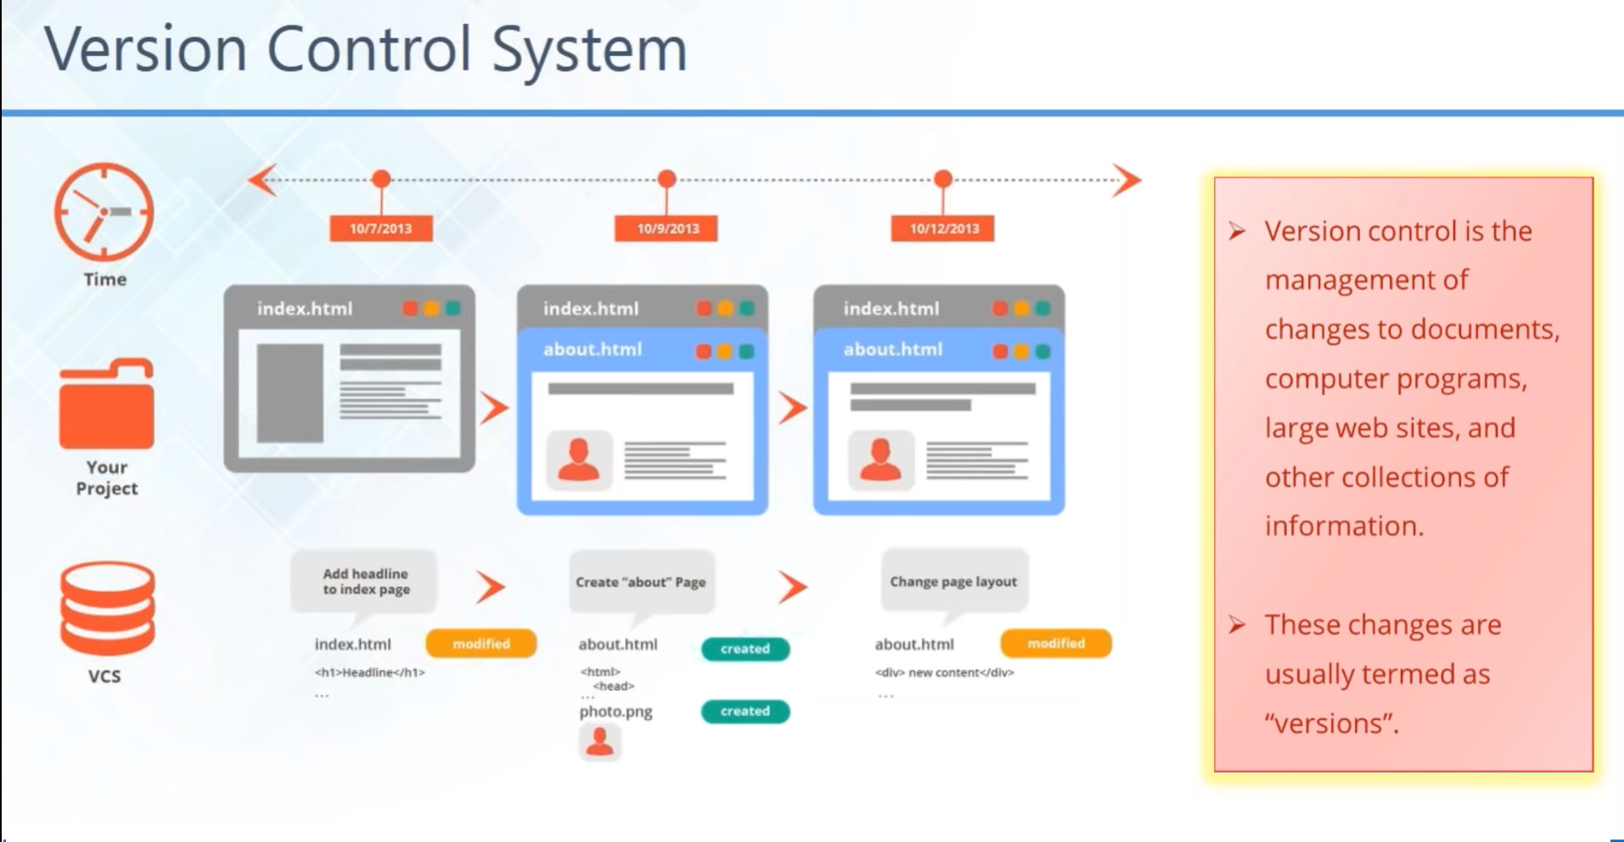

Slide 5
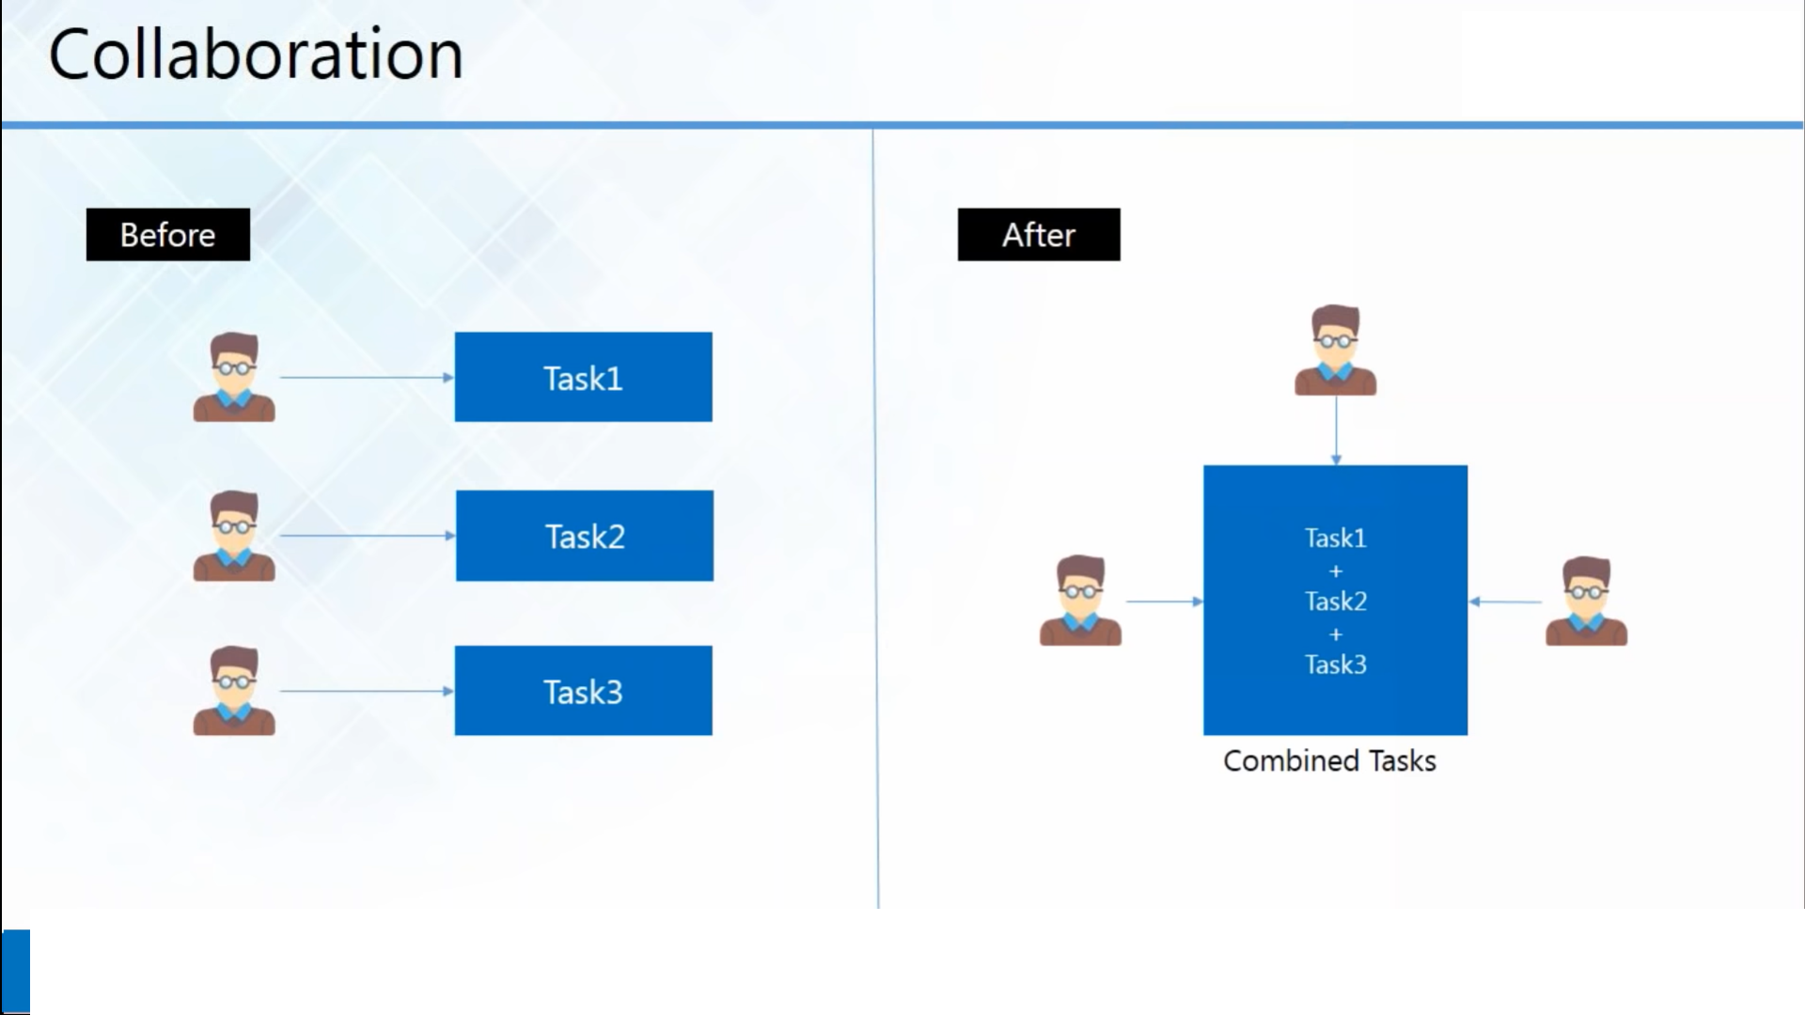

Slide 6
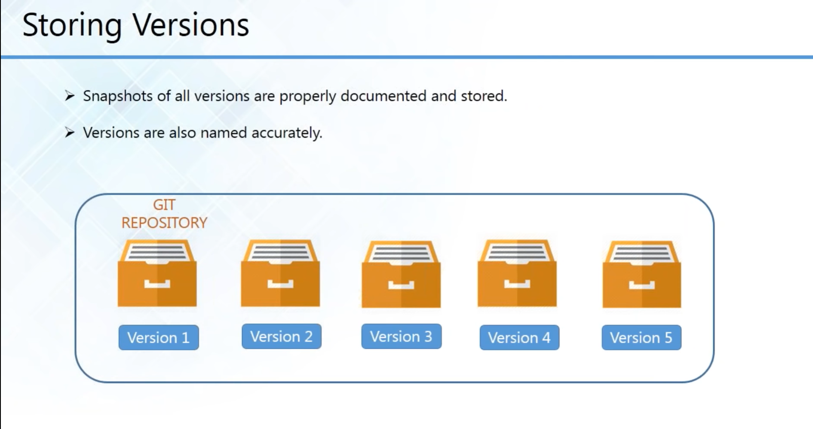

Slide 7
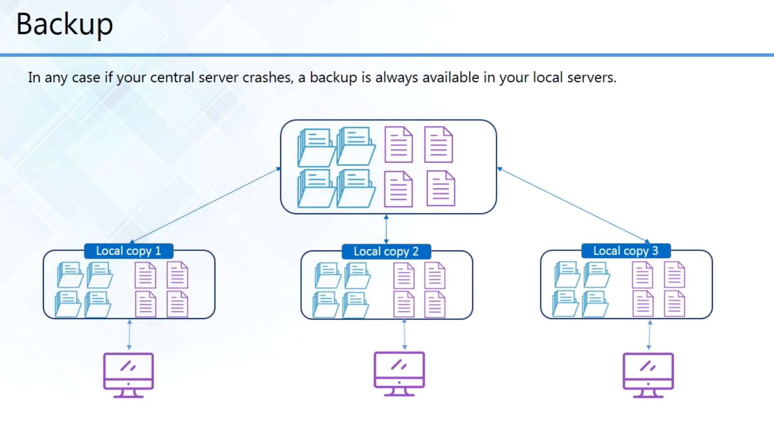

Slide 8
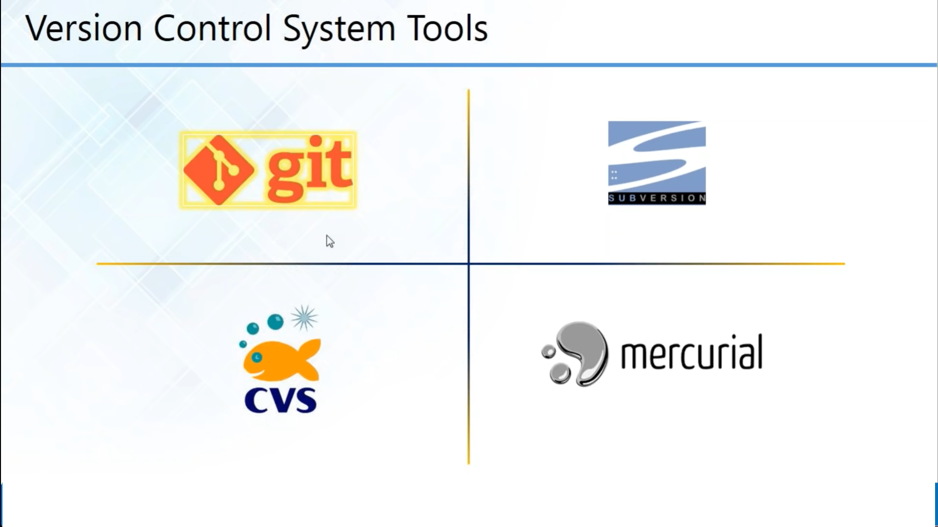

Slide 9
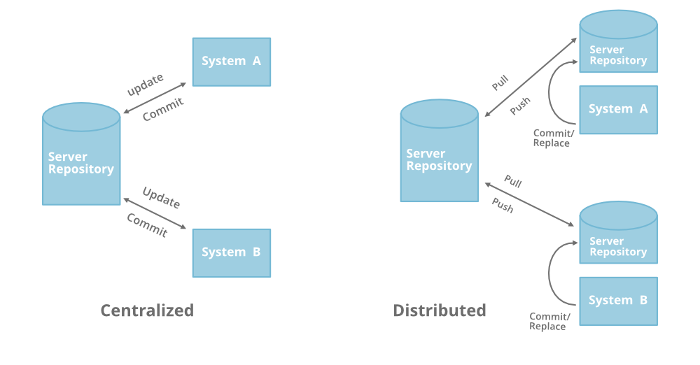
CVCS vs. DVCS

Slide 10
Centralized version control is easier to learn than distributed. If you are a beginner you’ll have to remember all the commands for all the operations in DVCS and working on DVCS might be confusing initially. CVCS is easy to learn and easy to set up. | DVCS has the biggest advantage that it allows you to work offline and gives flexibility. You have the entire history of the code in your own hard drive, so all the changes you will be making in your own server or to your own repository which doesn’t require internet connection, but this is not in case of CVCS.
CVCS is slower, since you need to communicate with the remote server through out | DVCS is faster than CVCS because you don’t need to communicate with the remote server for each and every command. You do everything locally which gives you benefit to work faster than CVCS.
In CVCS it’s difficult and time-consuming to work on branches because it requires to communicate with the server directly. | Working on branches is easy in DVCS. Every developer has an entire history of the code in DVCS, so developers can share their changes before merging all the ‘set of changes’ to the remote server
in CVCS you just need to get few lines of code because you don’t need to save the entire history or complete project in your own server so there is no requirement for additional space. | If the project has long history or the project contain large binary files in that case downloading the entire project in DVCS can take more time and space than usual

Slide 11
This is not in case of CVCS, there is just a single remote server which has entire code history. | If the main server goes down or it crashes in DVCS, you can still get the backup or entire history of the code from your local repository or server where the full revision of the code is already saved.
Merge conflicts are more in CVCS in comparison of DVCS. | Merge conflicts with other developers code are less in DVCS. Because of every developer work on their own piece of code.
In CVCS, developers cannot work in isolation, and hence are connected | In DVCS, sometimes developer take the advantage of having the entire history of the code and they may work for too long in isolation which is not a good thing.

Slide 12
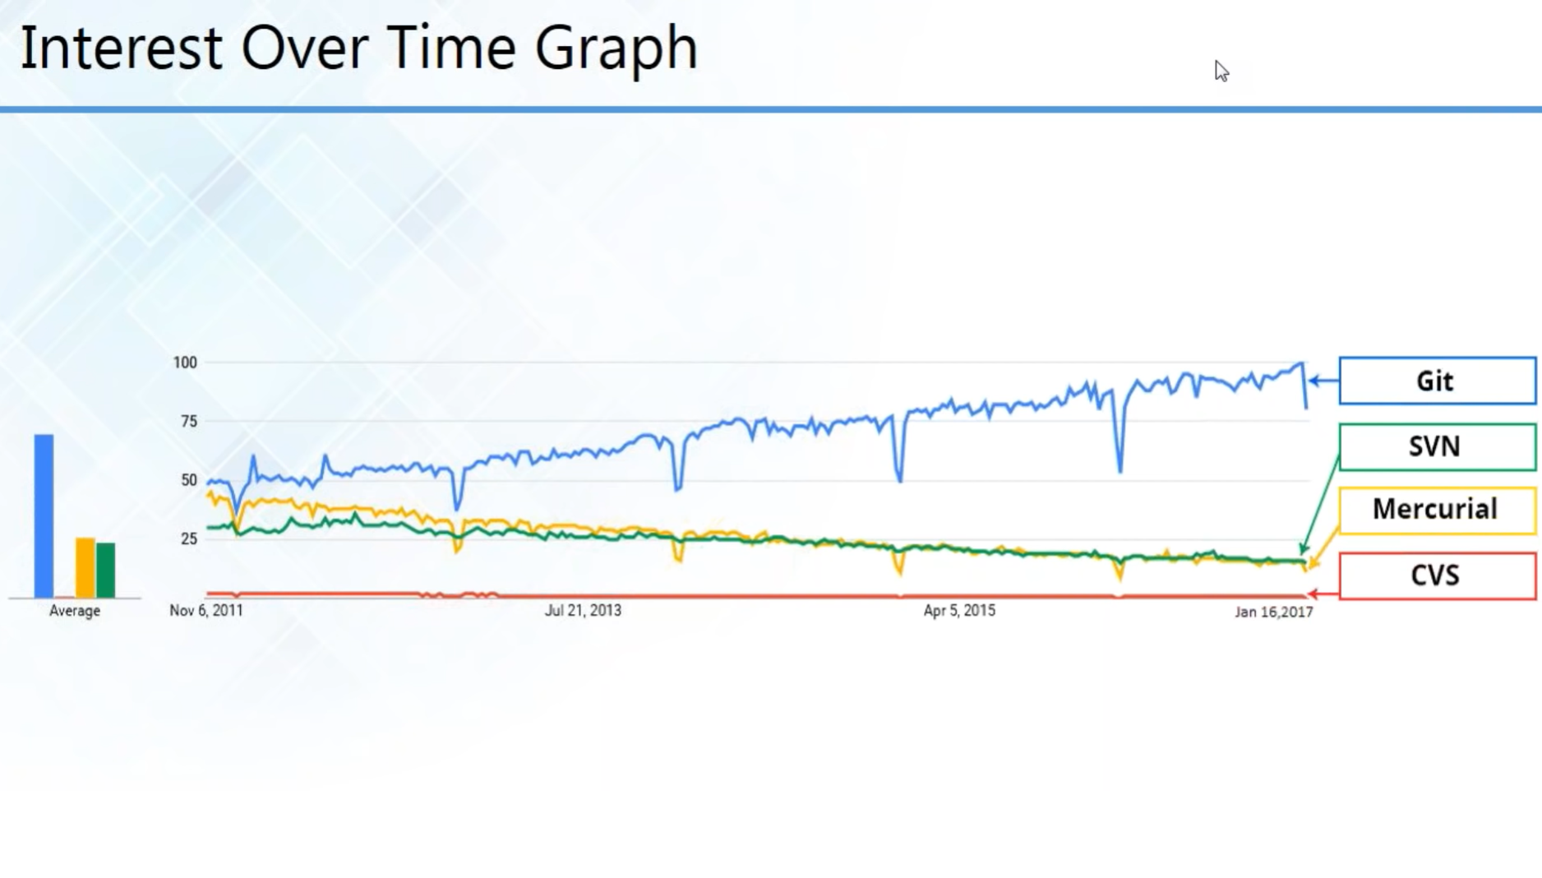

Slide 13
A Short History of Git
As with many great things in life, Git began with a bit of creative destruction and fiery controversy.
The Linux kernel is an open source software project of fairly large scope. For most of the lifetime of the Linux kernel maintenance (1991–2002), changes to the software were passed around as patches and archived files. In 2002, the Linux kernel project began using a proprietary DVCS called BitKeeper.
In 2005, the relationship between the community that developed the Linux kernel and the commercial company that developed BitKeeper broke down

Slide 14
This prompted the Linux development community (and in particular Linus Torvalds, the creator of Linux) to develop their own tool based on some of the lessons they learned while using BitKeeper. Some of the goals of the new system were as follows:
Speed
Simple design
Strong support for non-linear development (thousands of parallel branches)
Fully distributed
Able to handle large projects like the Linux kernel efficiently (speed and data size)

Slide 15
Git- Way of storing and working
Git doesn’t store data as a series of changesets or differences, but instead as a series of snapshots.
When you make a commit, Git stores a commit object that contains a pointer to the snapshot of the content you staged. This object also contains the author’s name and email address, the message that you typed, and pointers to the commit or commits that directly came before this commit or a merge of two or more branches.

Slide 16
To visualize this, let’s assume that you have a directory containing three files, and you stage them all and commit. Staging the files computes a checksum for each one, stores that version of the file in the Git repository (Git refers to them as blobs), and adds that checksum to the staging area:
$ git add README test.rb LICENSE
$ git commit -m 'Initial commit'
When you create the commit by running git commit, Git checksums each subdirectory (in this case, just the root project directory) and stores them as a tree object in the Git repository. Git then creates a commit object that has the metadata and a pointer to the root project tree so it can re-create that snapshot when needed.
Your Git repository now contains five objects: three blobs (each representing the contents of one of the three files), one tree that lists the contents of the directory and specifies which file names are stored as which blobs, and one commit with the pointer to that root tree and all the commit metadata.

Slide 17
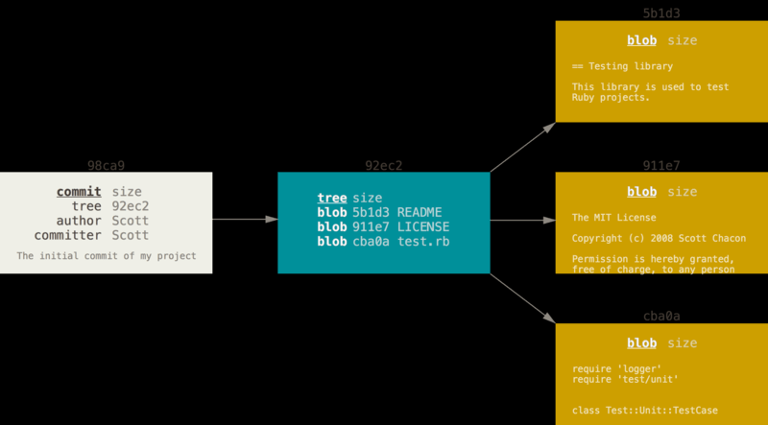

Slide 18
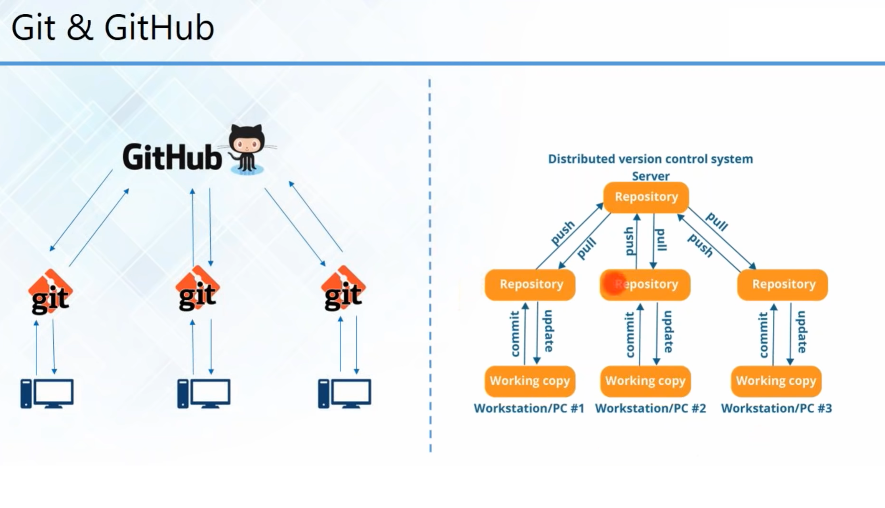

Slide 19
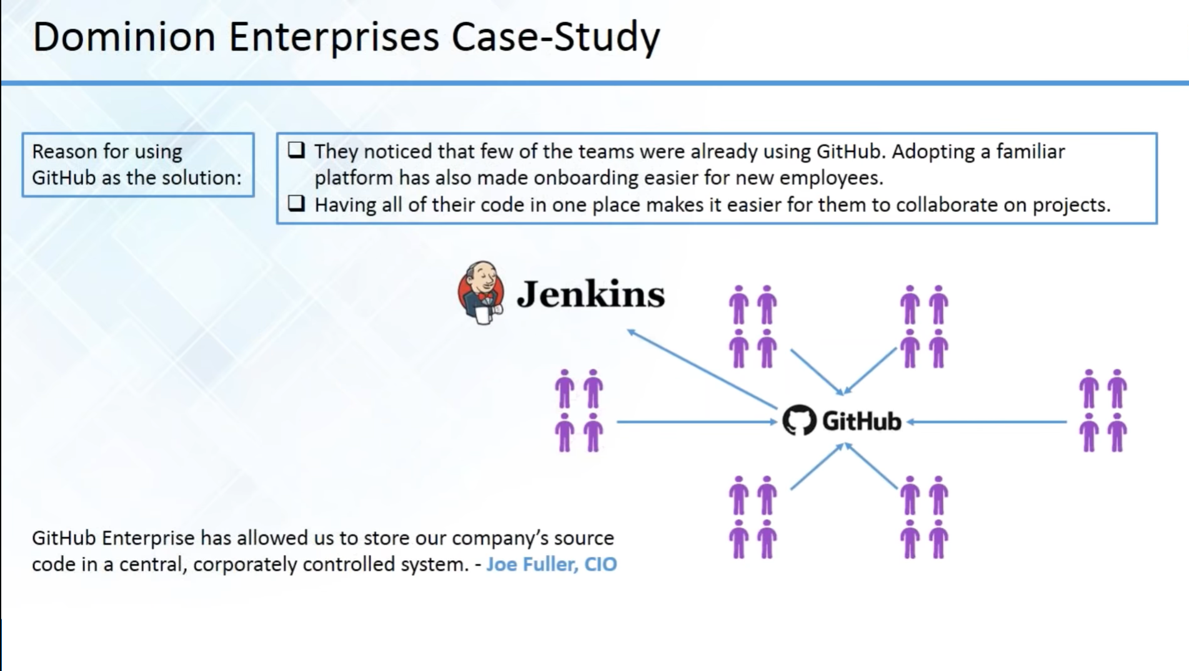

Slide 20
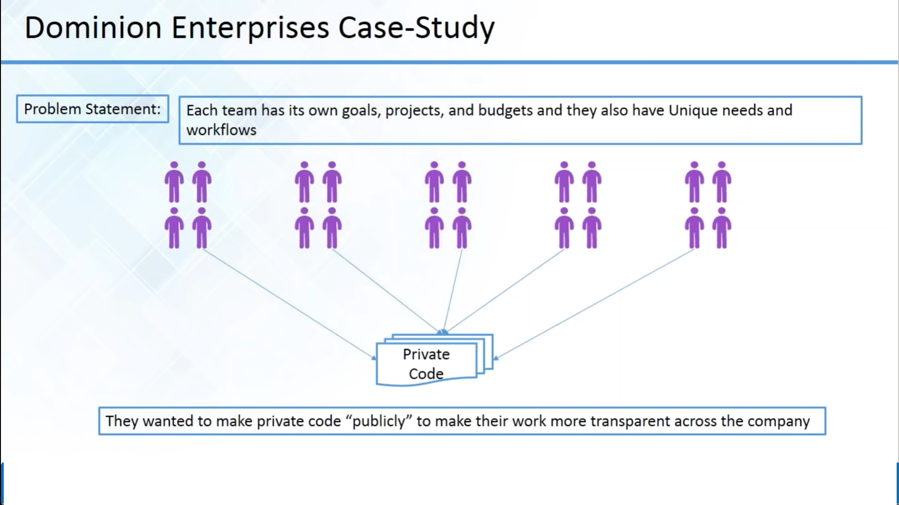

Slide 21
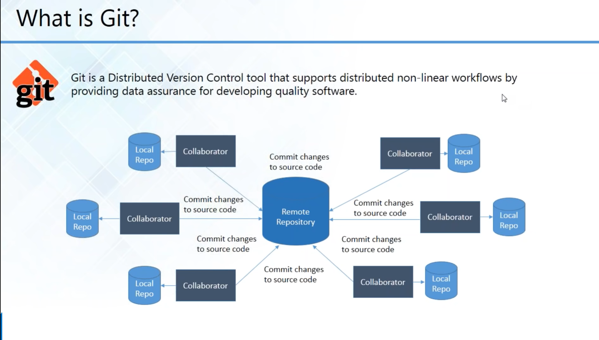

Slide 22
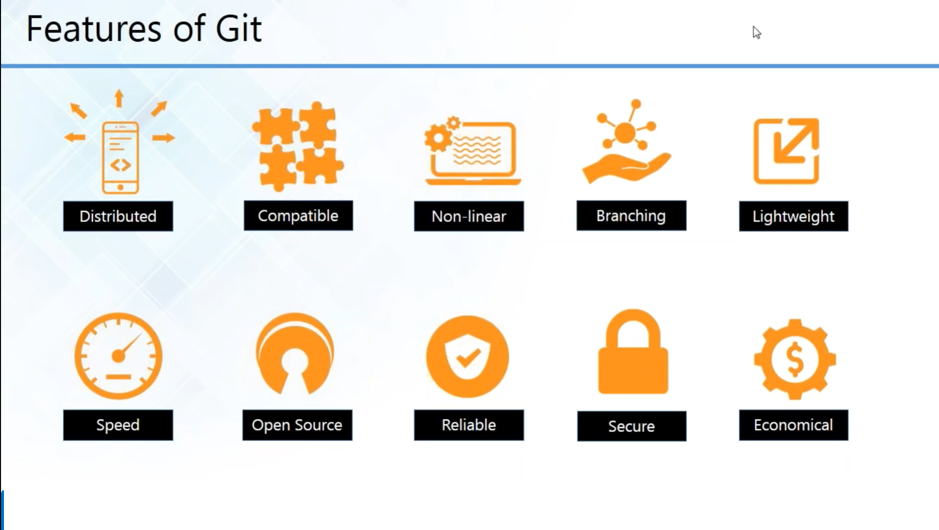

Slide 23
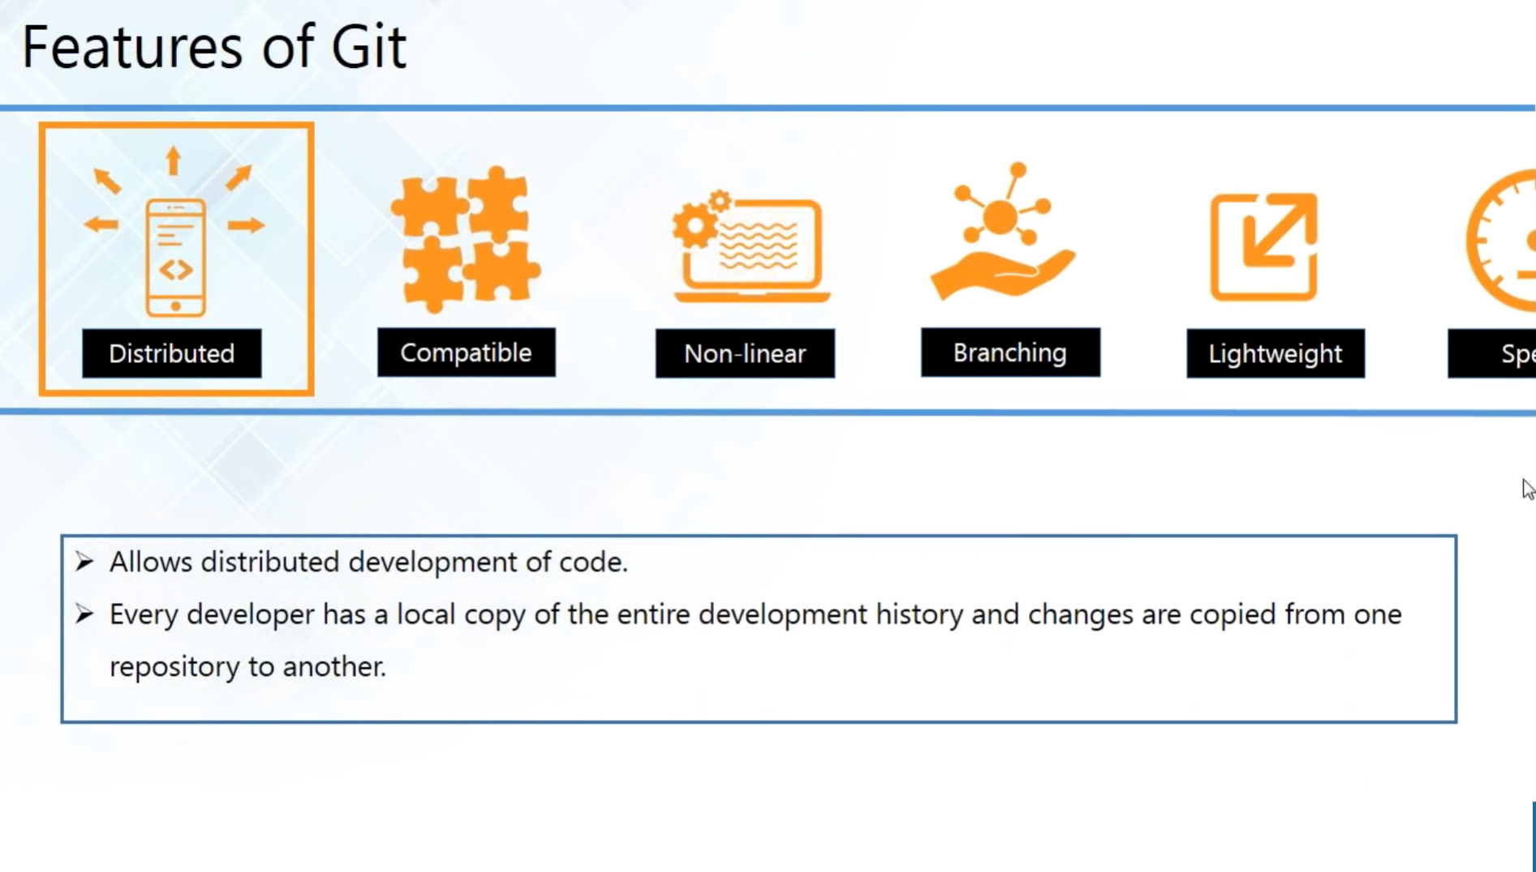

Slide 24
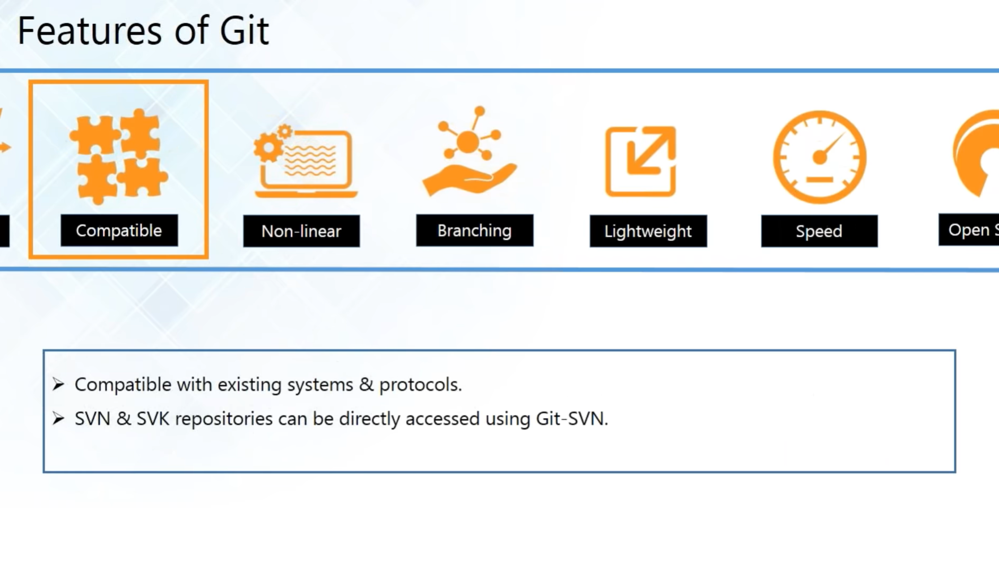

Slide 25
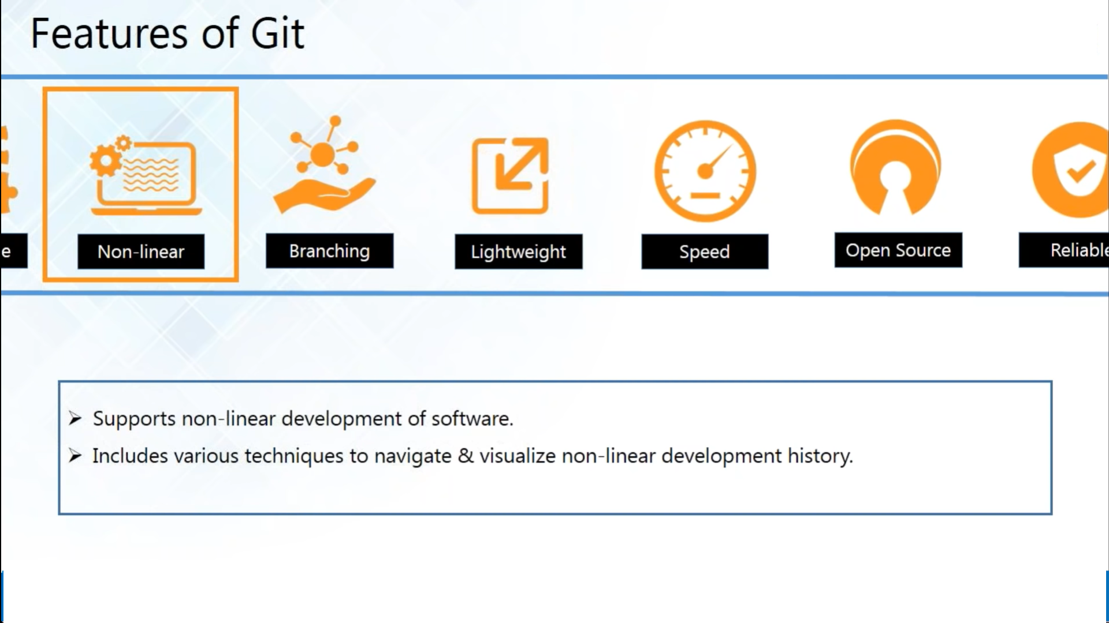

Slide 26
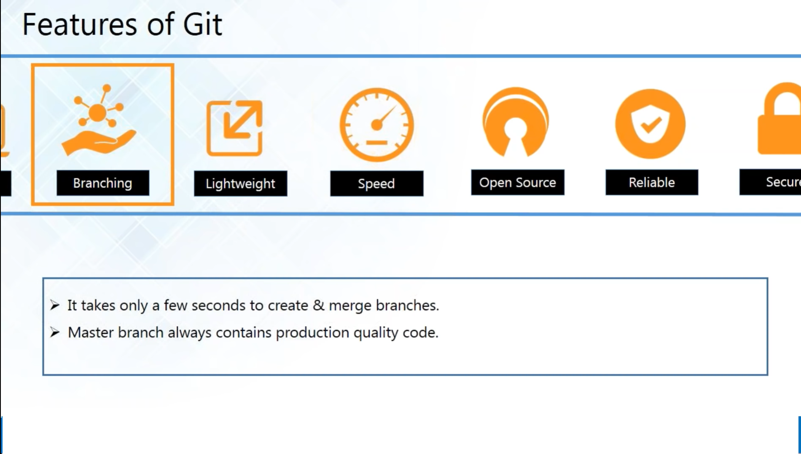

Slide 27
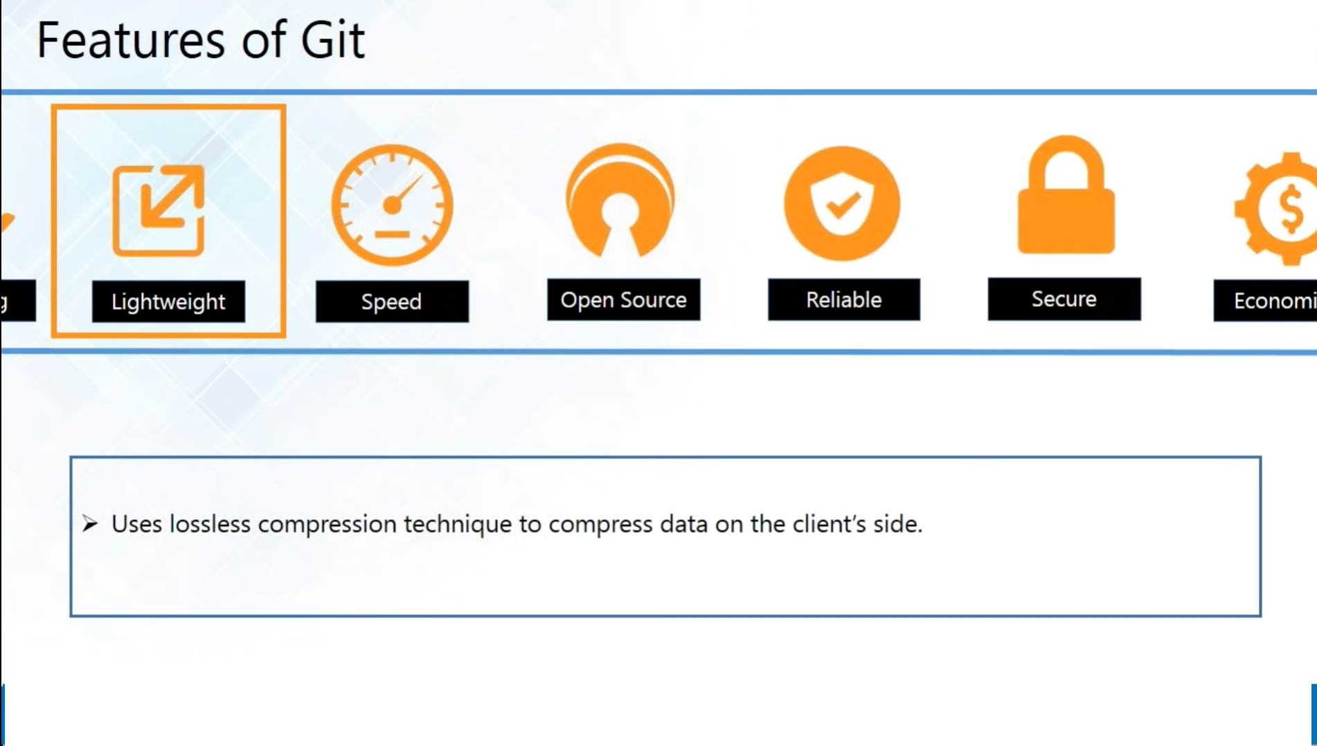

Slide 28
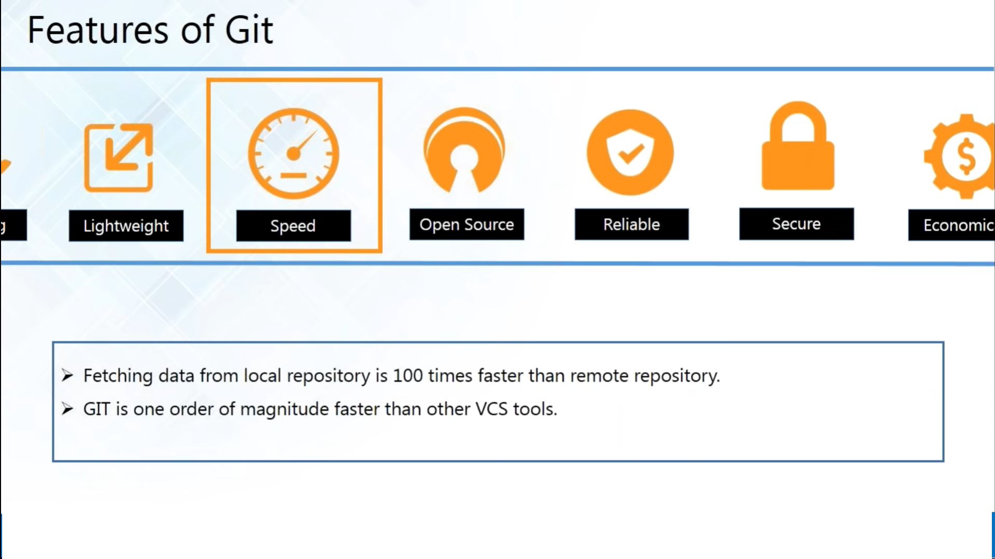

Slide 29
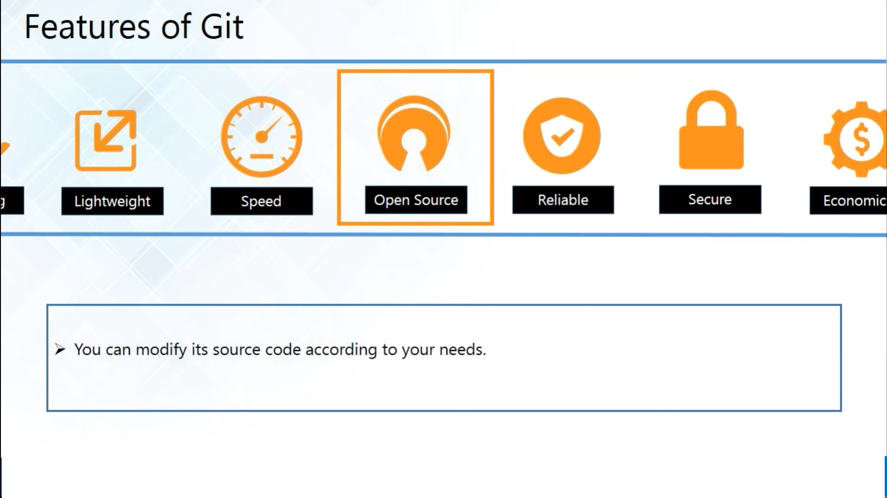

Slide 30
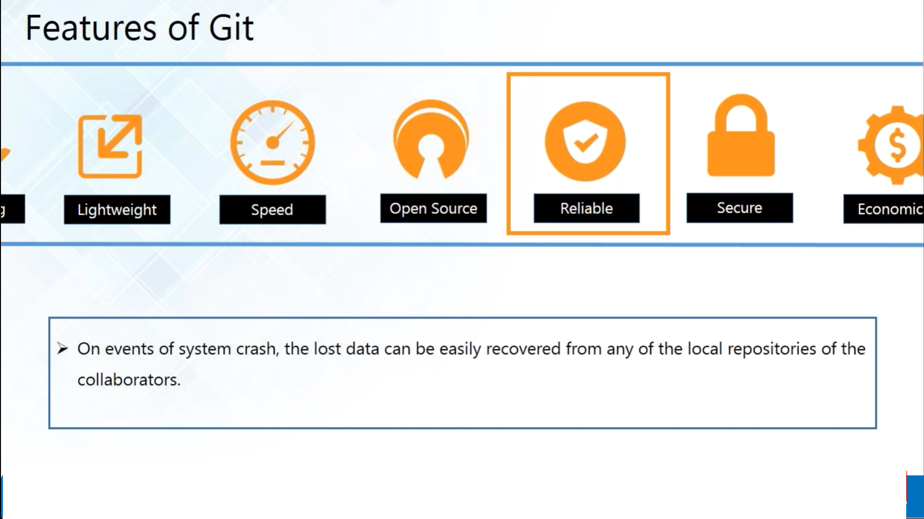

Slide 31
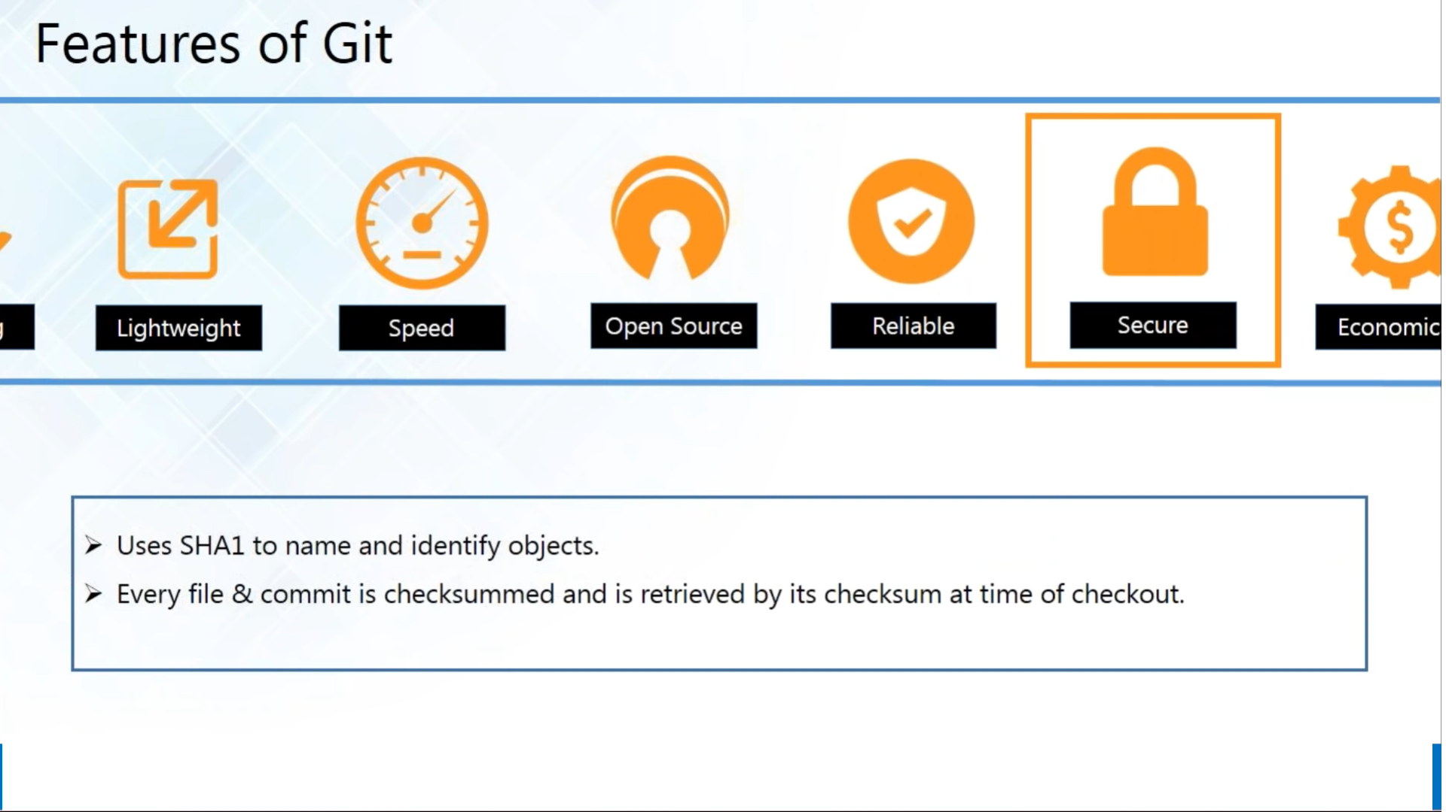

Slide 32
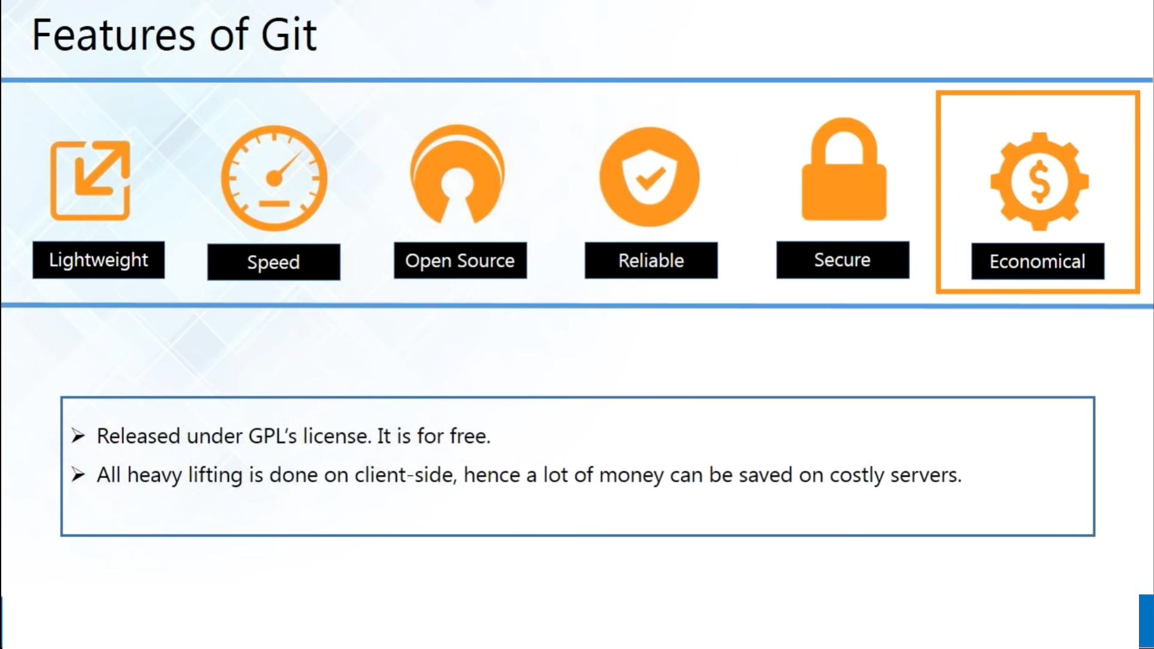

Slide 33
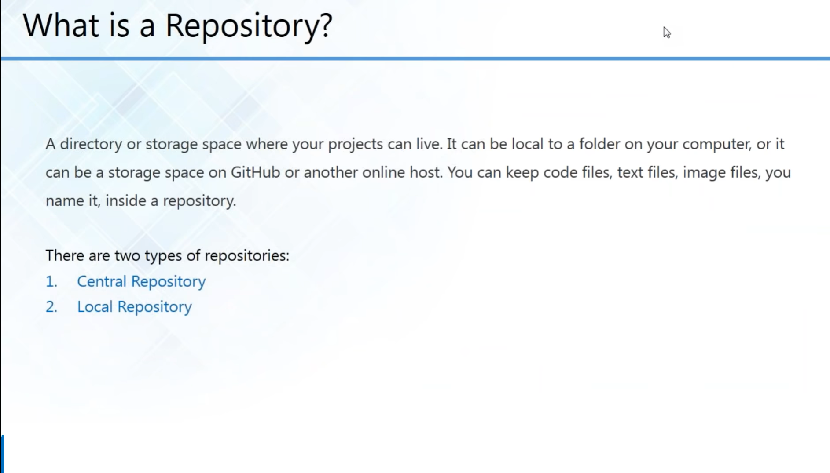

Slide 34
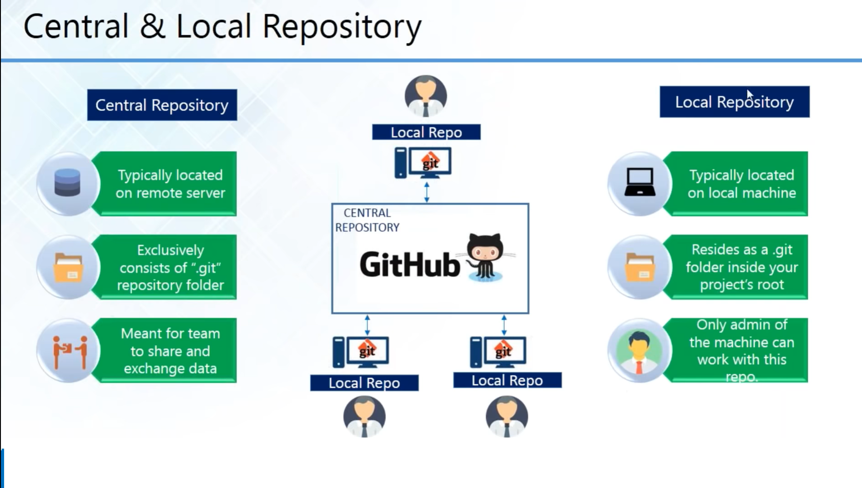

Slide 35
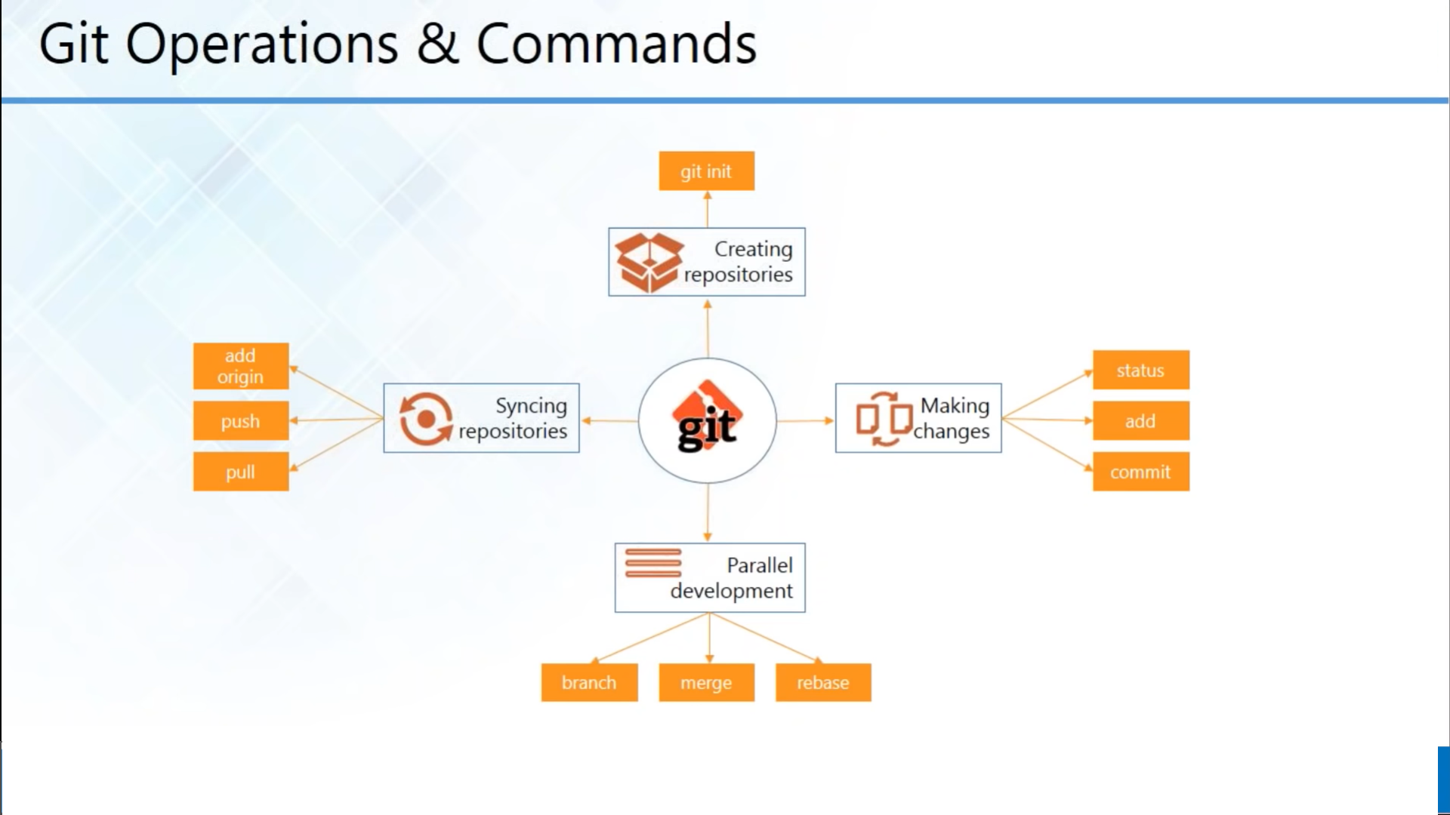

Slide 36
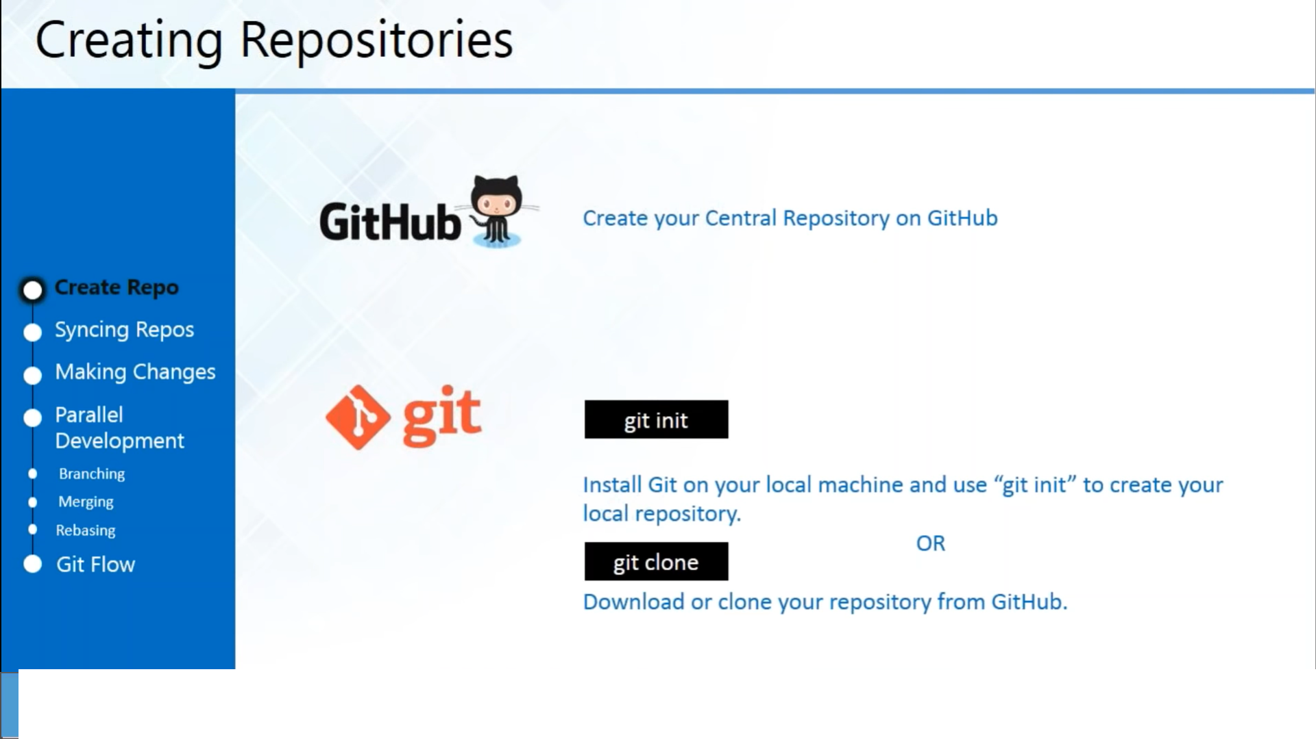

Slide 37
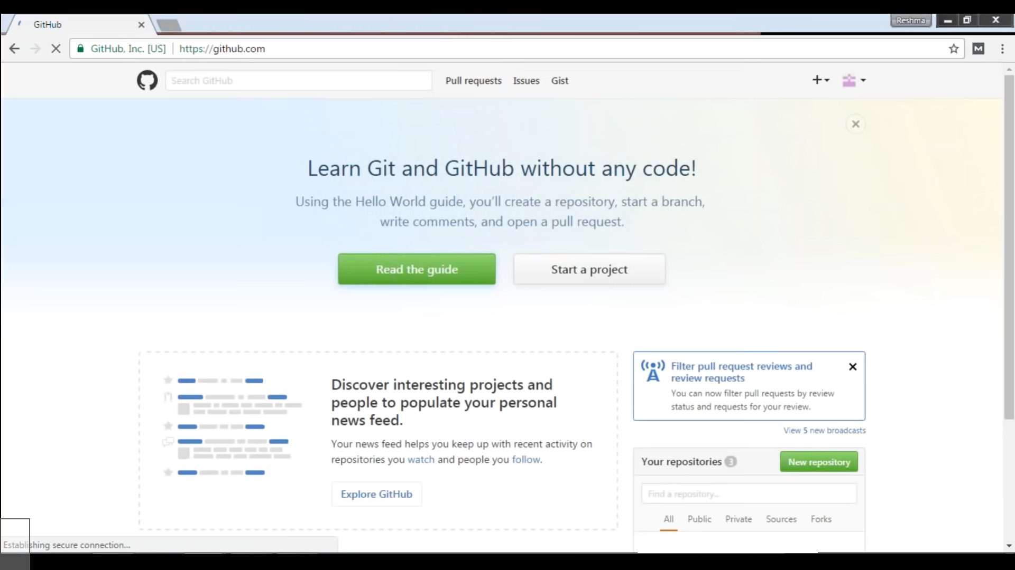

Slide 38
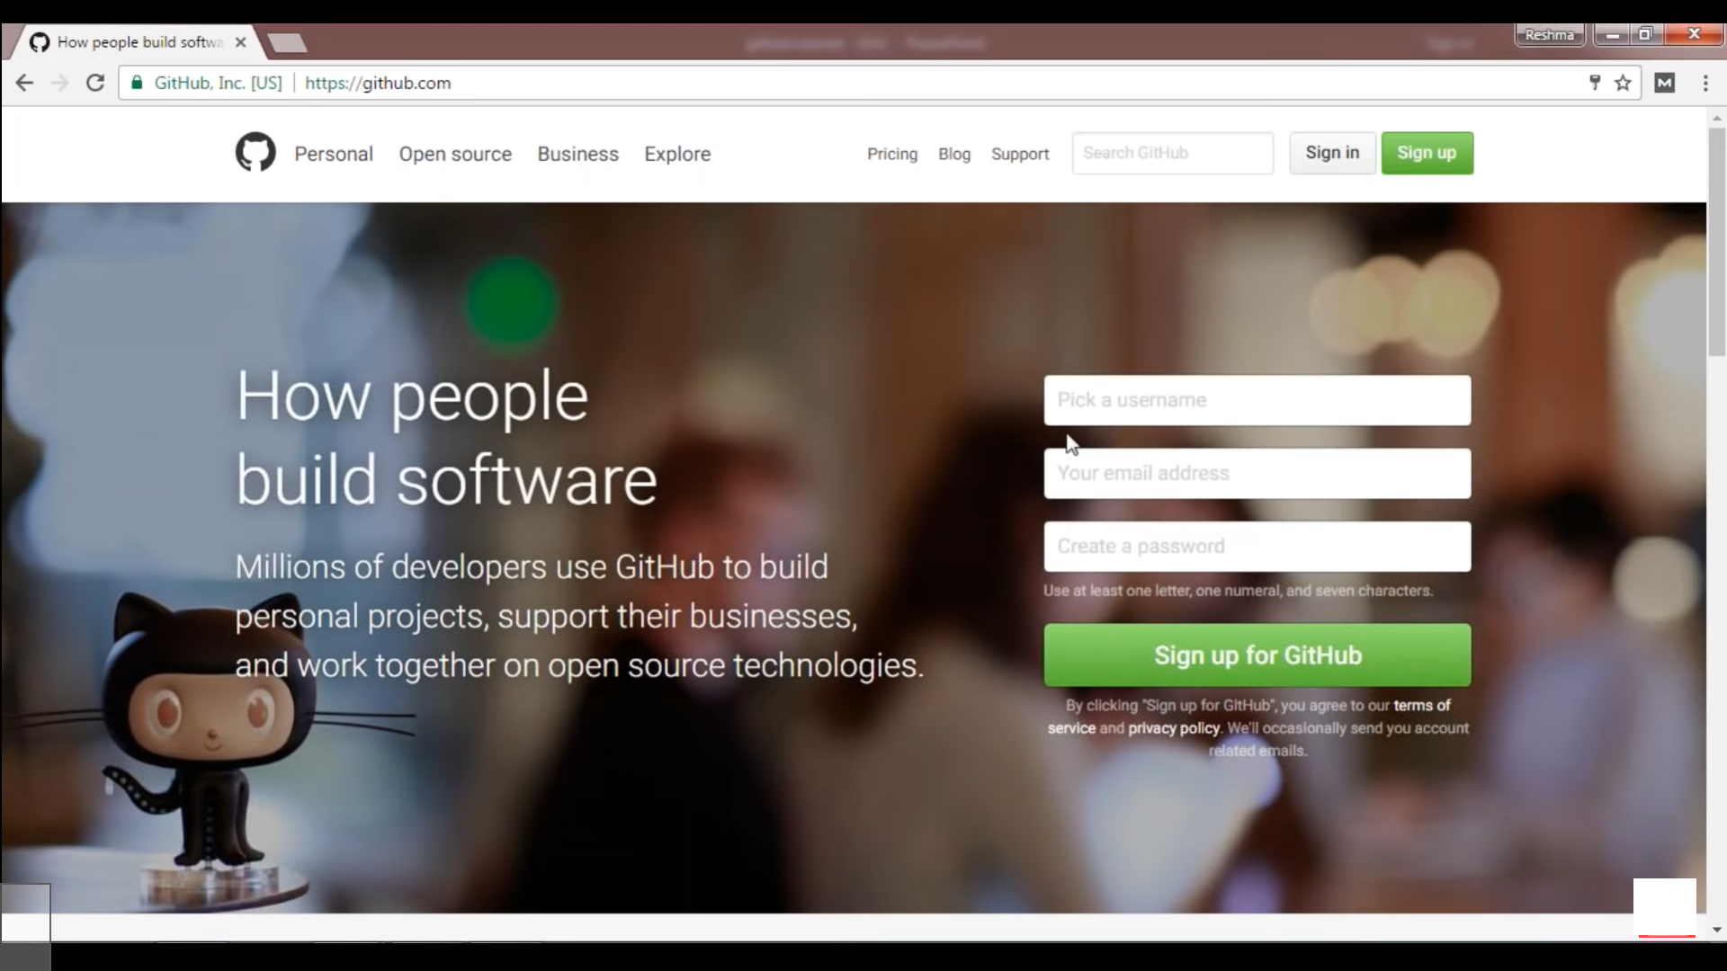

Slide 39
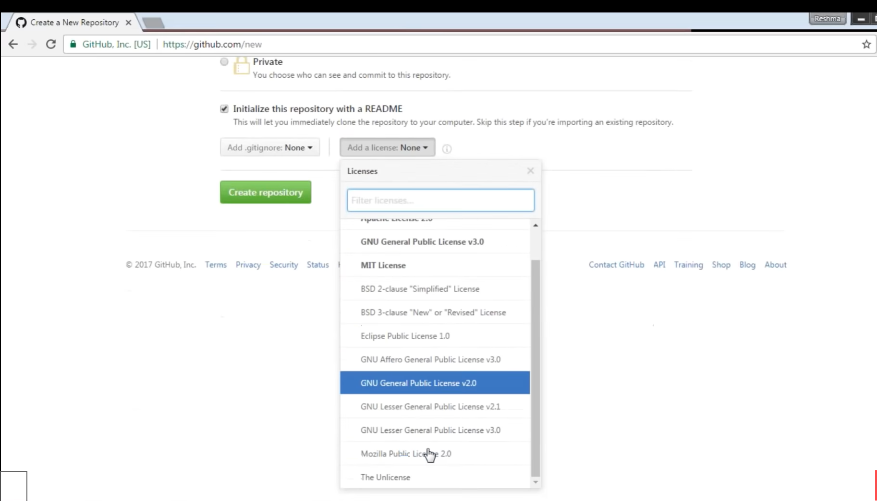

Slide 40
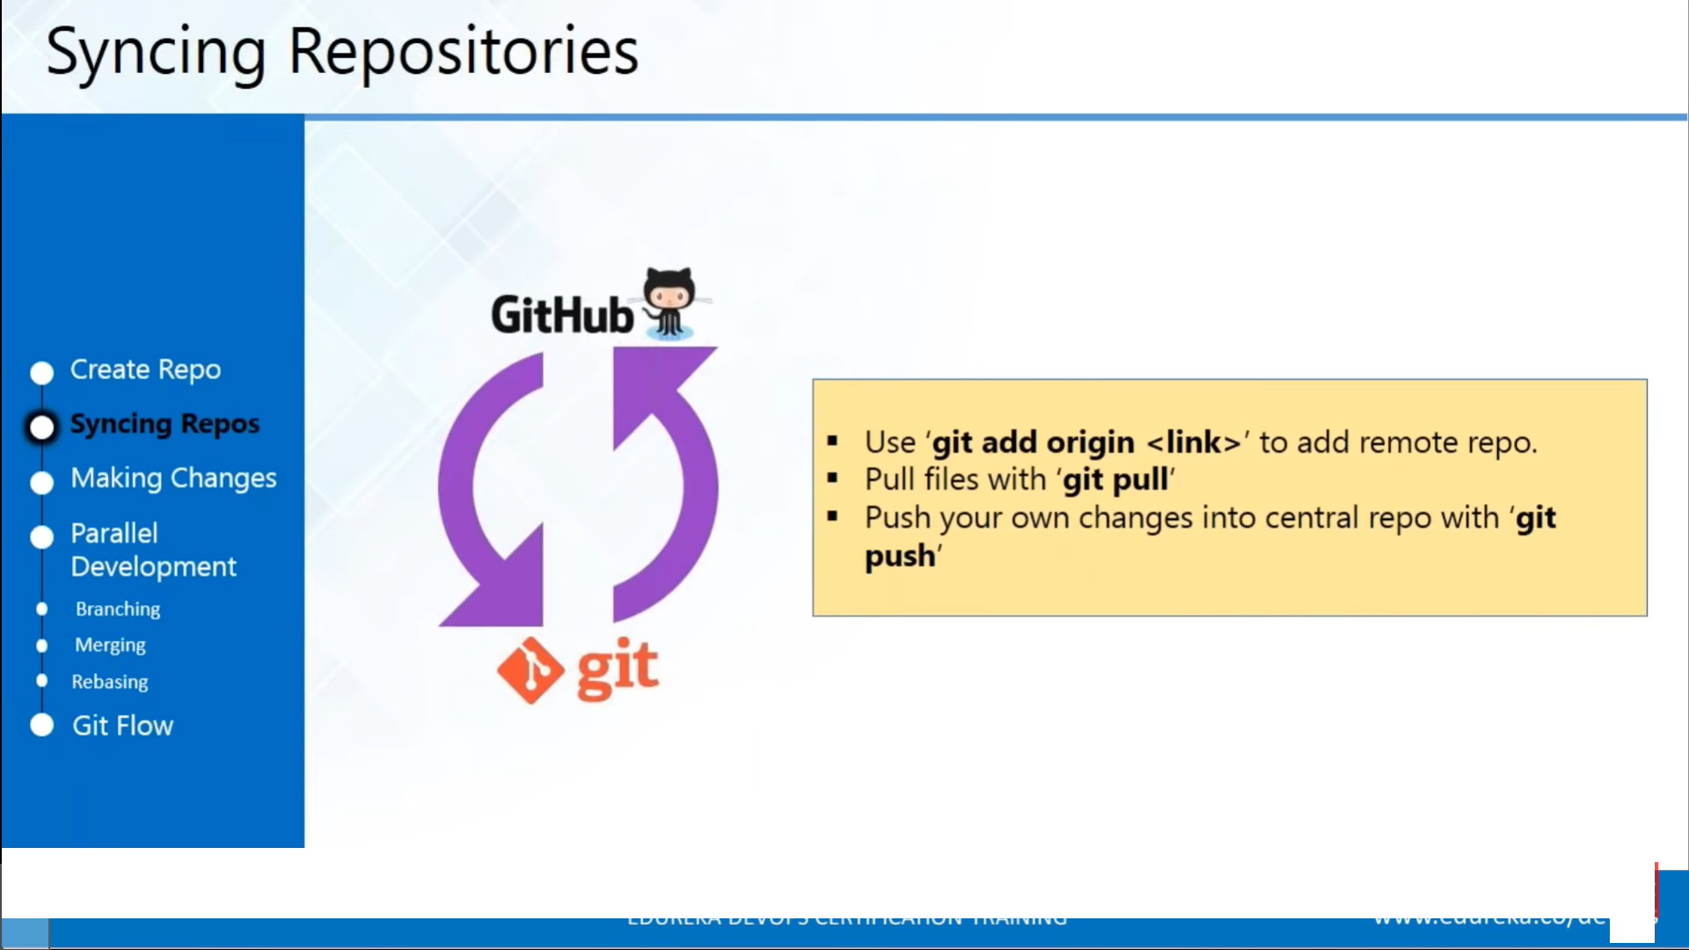

Slide 41
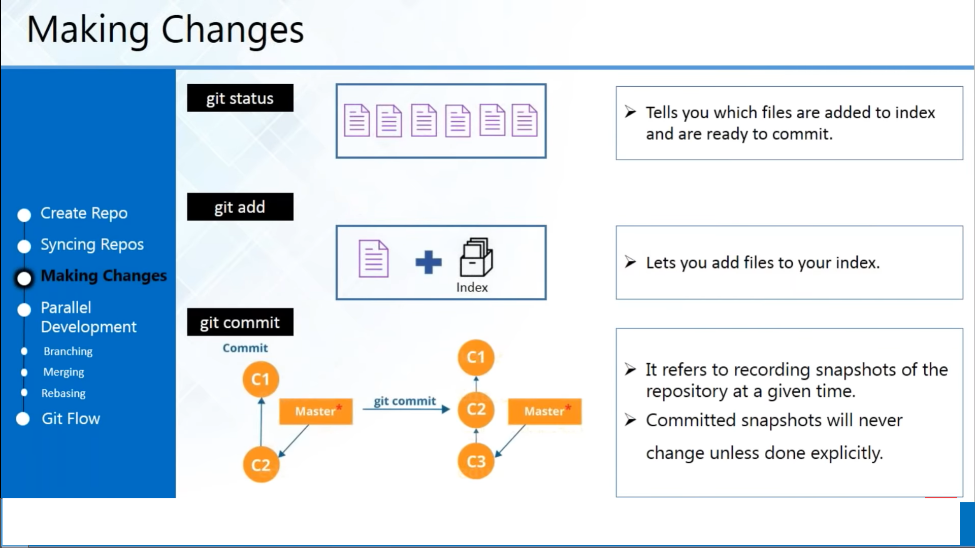

Slide 42
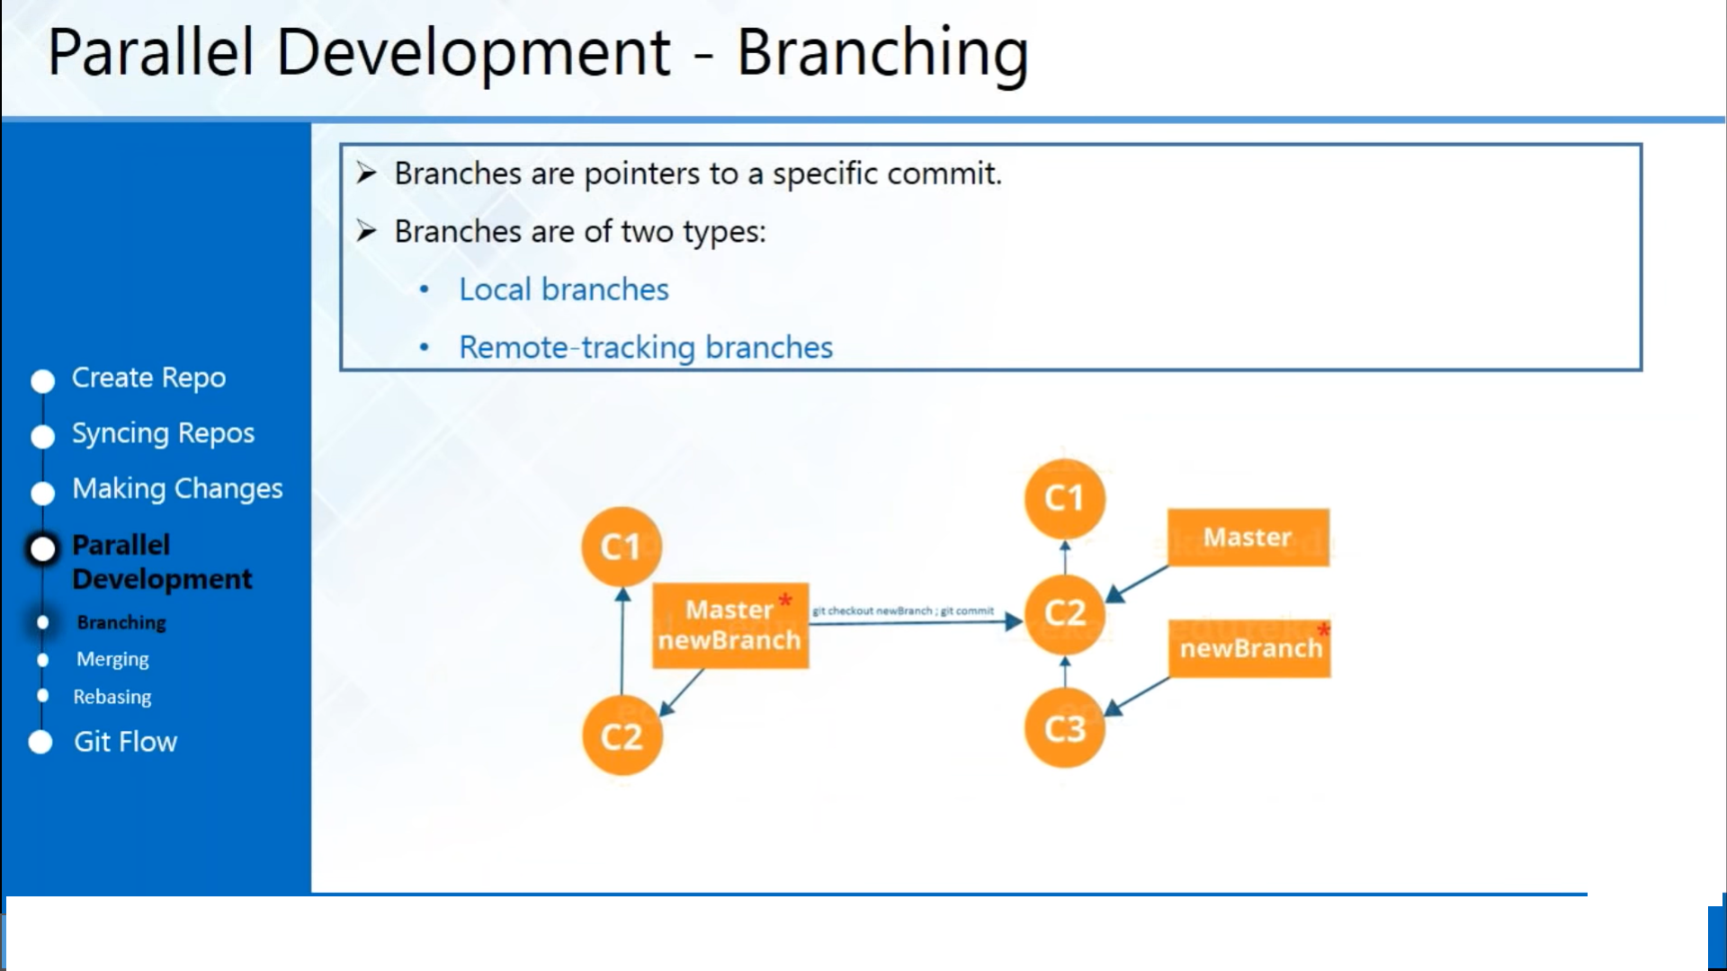

Slide 43
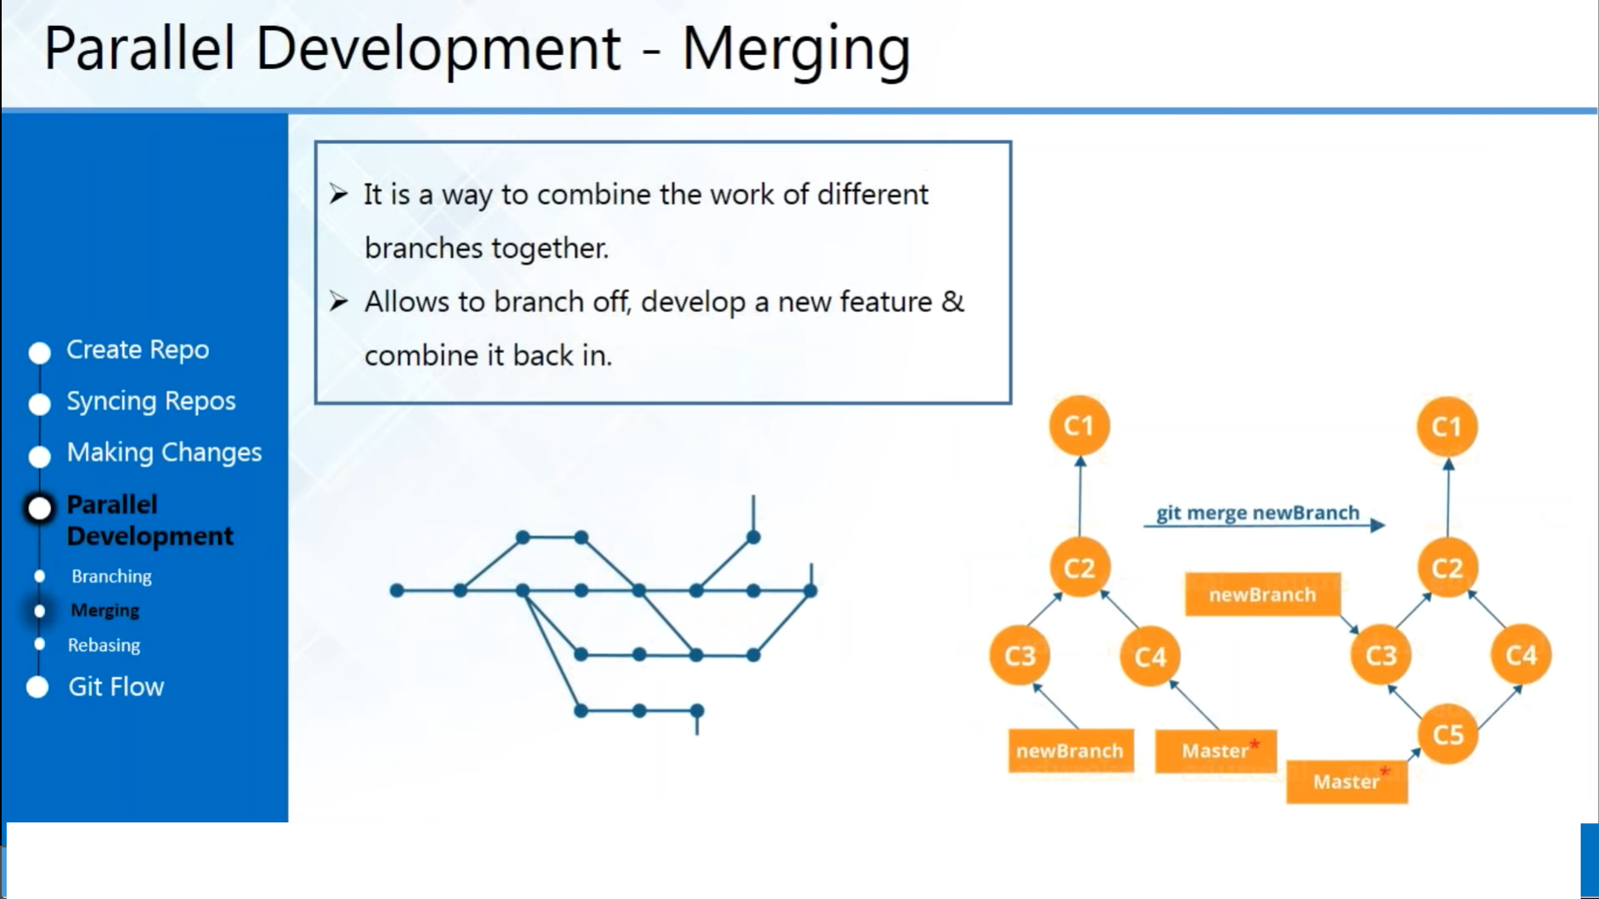

Slide 44
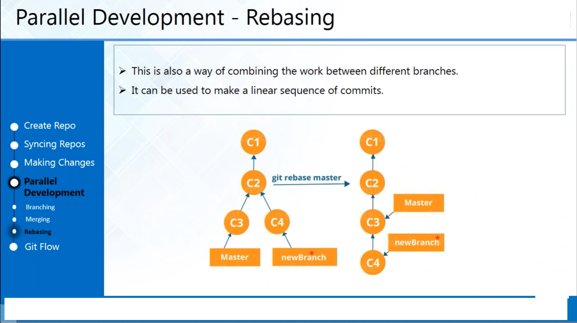

Slide 45
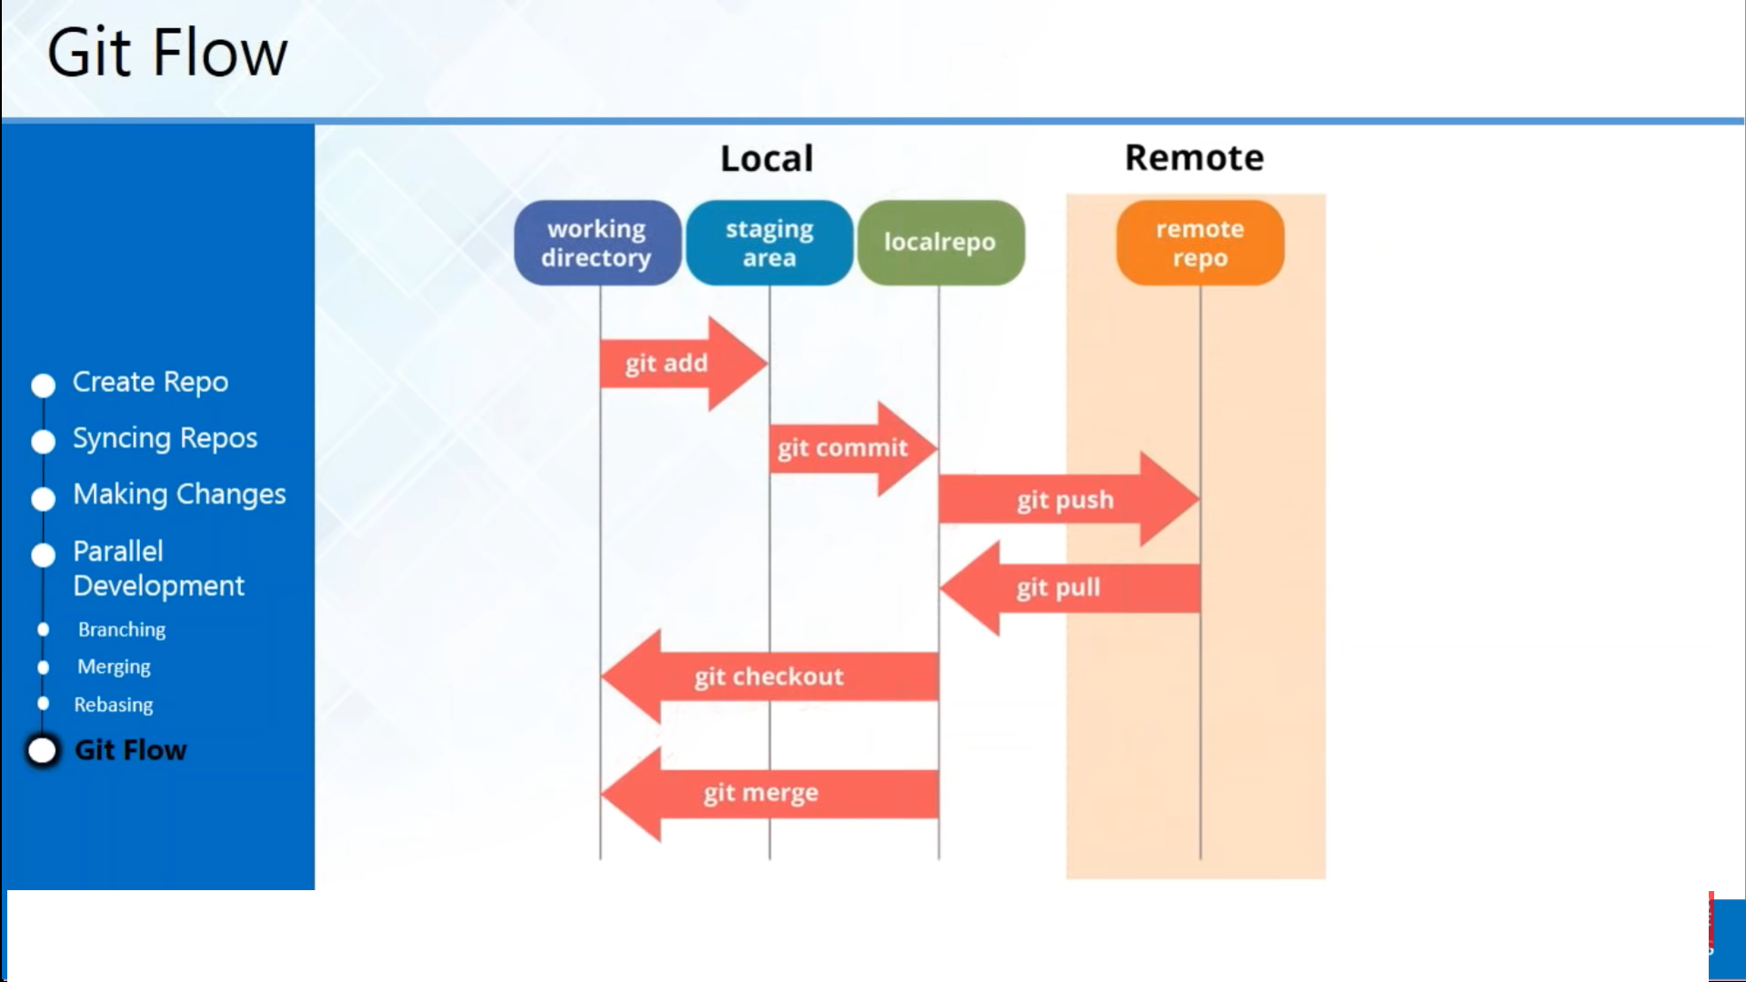

Slide 46
